Slide 1
Week 1 Class 2
Reference Frames

Slide 2
Reference Frames
In guidance and control of aircraft, reference frames used a lot
Describe relative position and orientation of objects
Aircraft relative to direction of wind
Camera relative to aircraft
Aircraft relative to inertial frame
Some things most easily calculated or described in certain reference frames
Newton’s law
Aircraft attitude
Aerodynamic forces/torques
Accelerometers, rate gyros
GPS
Mission requirements
Must know how to transform
between different reference
frames

Slide 3


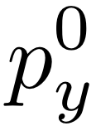

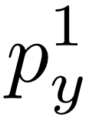

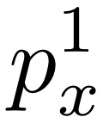


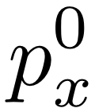

Rotation of Reference Frame
Notes:
\textbf{p} = p_x^0 \textbf{i}^0 + p_y^0 \textbf{j}^0 + p_z^0 \textbf{k}^0
\textbf{p} = p_x^1 \textbf{i}^1 + p_y^1 \textbf{j}^1 + p_z^1 \textbf{k}^1
p_x^1 \textbf{i}^1 + p_y^1 \textbf{j}^1 + p_z^1 \textbf{k}^1 = p_x^0 \textbf{i}^0 + p_y^0 \textbf{j}^0 + p_z^0 \textbf{k}^0
\textbf{p}^1 \stackrel{\triangle}{=} \begin{pmatrix}
p_x^1 \\
p_y^1 \\
p_z^1
\end{pmatrix} = \begin{pmatrix}
\textbf{i}^1 \cdot \textbf{i}^0 & \textbf{i}^1 \cdot \textbf{j}^0 & \textbf{i}^1 \cdot \textbf{k}^0 \\
\textbf{j}^1 \cdot \textbf{i}^0 & \textbf{j}^1 \cdot \textbf{j}^0 & \textbf{j}^1 \cdot \textbf{k}^0 \\
\textbf{k}^1 \cdot \textbf{i}^0 & \textbf{k}^1 \cdot \textbf{j}^0 & \textbf{k}^1 \cdot \textbf{k}^0
\end{pmatrix} \begin{pmatrix}
p_x^0 \\
p_y^0 \\
p_z^0
\end{pmatrix}
\textbf{p}^1 = \mathcal{R}_0^1 \textbf{p}^0
Where
\mathcal{R}_0^1 \stackrel{\triangle}{=} \begin{pmatrix}
\cos\theta & \sin\theta & 0 \\
-\!\sin\theta & \cos\theta & 0 \\
0 & 0 & 1
\end{pmatrix}
(rotation about $\textbf{k}$ axis)

Slide 4
Rotation of Reference Frame
Notes:
\noindent
Right-handed rotation about $\textbf{j}$ axis:
\[
\mathcal{R}_0^1 \stackrel{\triangle}{=} \begin{pmatrix}
\cos\theta & 0 & -\!\sin\theta \\
0 & 1 & 0 \\
\sin\theta & 0 & \cos\theta
\end{pmatrix}
\]
\noindent
Right-handed rotation about $\textbf{i}$ axis:
\[
\mathcal{R}_0^1 \stackrel{\triangle}{=} \begin{pmatrix}
1 & 0 & 0 \\
0 & \cos\theta & \sin\theta \\
0 & -\!\sin\theta & \cos\theta
\end{pmatrix}
\]
\noindent
Orthonormal matrix properties:
\begin{itemize}
\item[{\bf P.1.}] $(\mathcal{R}_a^b)^{-1} = (\mathcal{R}_a^b)^{\top} = \mathcal{R}_b^a$
\item[{\bf P.2.}] $\mathcal{R}_b^c \mathcal{R}_a^b = \mathcal{R}_a^c$
\item[{\bf P.3.}] $\det\!\left(\mathcal{R}_a^b\right) = 1$
\end{itemize}

Slide 5
Rotation Formula

Slide 6
Rotation Formula

Slide 7
Rotation Formula

Slide 8
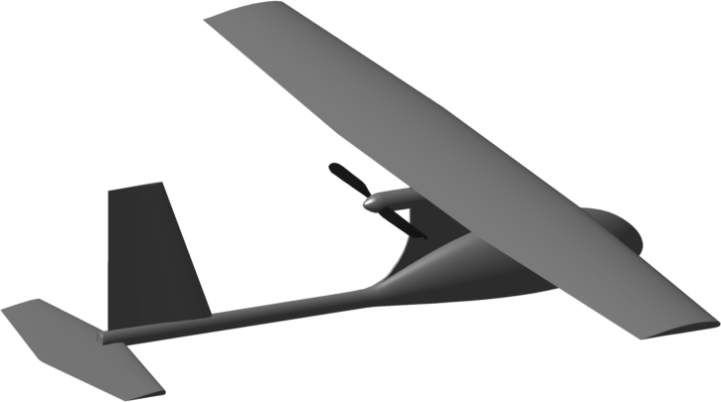
Inertial Frame and Vehicle Frame
Notes:
\begin{itemize}
\item Vehicle frame has same orientation
as inertial frame
\item Vehicle frame is fixed at cm of aircraft
\item Inertial and vehicle frames are referred
to as NED frames
\item $N \longrightarrow x$, $E \longrightarrow y$, $D \longrightarrow z$
\end{itemize}

Slide 9
Euler Angles
Need way to describe attitude of aircraft
Common approach: Euler angles
Pro: Intuitive
Con: Mathematical singularity
Quaternions are alternative for overcoming singularity
Notes:
$\psi$: heading (yaw)
\vspace{.5cm}
$\theta$: elevation (pitch)
\vspace{.5cm}
$\phi$: bank (roll)

Slide 10
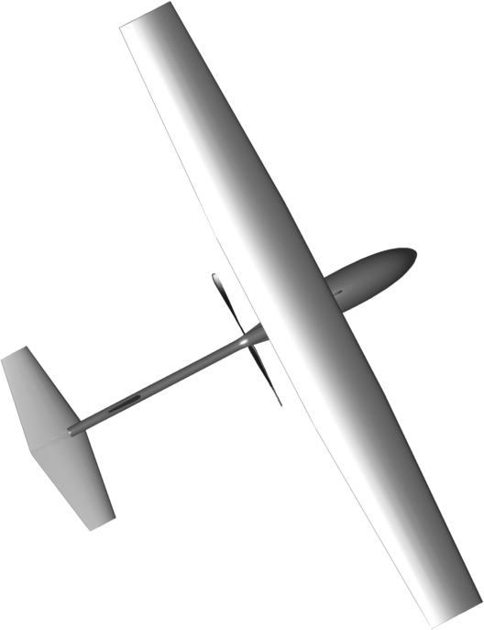
Vehicle-1 Frame
Notes:
\[
\mathcal{R}_v^{v1}(\psi) =
\begin{pmatrix}
\cos\psi & \sin\psi & 0 \\
-\sin\psi & \cos\psi & 0 \\
0 & 0 & 1
\end{pmatrix}
\]
gives
\[
\mathbf{p}^{v1} = \mathcal{R}_v^{v1}(\psi) \mathbf{p}^v
\]
where $\psi$ is the heading.

Slide 11
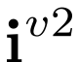
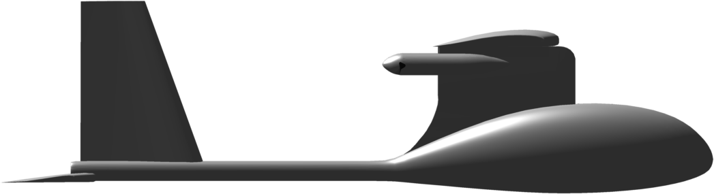
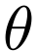
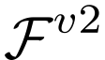
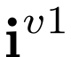
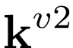
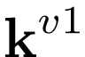
Vehicle-2 Frame
Notes:
\renewcommand{\textwidth}{2in}
\[
\mathcal{R}_{v1}^{v2}(\theta) =
\begin{pmatrix}
\cos\theta& 0 & -\sin\theta \\
0 & 1 & 0 \\
\sin\theta & 0 & \cos\theta
\end{pmatrix}
\]
gives
\[
\mathbf{p}^{v2} = \mathcal{R}_{v1}^{v2}(\theta) \mathbf{p}^{v1}
\]
where $\theta$ is the pitch angle.

Slide 12
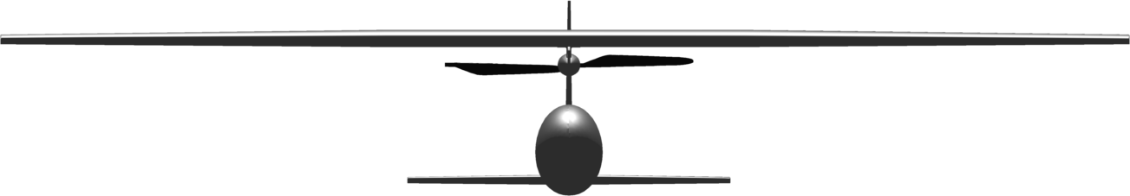
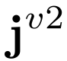
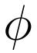
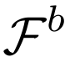
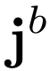
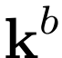
Body Frame
Notes:
\renewcommand{\textwidth}{2in}
\[
\mathcal{R}_{v2}^{ b}(\phi) =
\begin{pmatrix}
1 & 0 & 0 \\
0 & \cos\phi & \sin\phi \\
0 & -\sin\phi & \cos\phi
\end{pmatrix}
\]
gives
\[
\mathbf{p}^{b} = \mathcal{R}_{v2}^{ b}(\phi) \mathbf{p}^{v2}
\]
where $\phi$ is the roll (bank) angle.

Slide 13
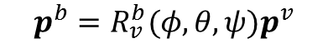
Inertial Frame to Body Frame Transformation
$$p^{b}=R_{v}^{b}(φ,θ,ψ)p^{v}$$
Notes:
\newcommand{\cth}{c_{\theta}}
\newcommand{\sth}{s_{\theta}}
\newcommand{\cps}{c_{\psi}}
\newcommand{\sps}{s_{\psi}}
\newcommand{\cph}{c_{\phi}}
\newcommand{\sph}{s_{\phi}}
Define
\begin{align*}
\mathcal{R}_{v}^{ b}(\phi,\theta,\psi) &= \mathcal{R}_{v2}^{b}(\phi) \mathcal{R}_{v1}^{v2}(\theta) \mathcal{R}_{v}^{v1}(\psi) \\
&=
\begin{pmatrix}
1 & 0 & 0 \\
0 & \cos\phi & \sin\phi \\
0 & -\sin\phi & \cos\phi
\end{pmatrix}
\begin{pmatrix}
\cos\theta& 0 & -\sin\theta \\
0 & 1 & 0 \\
\sin\theta & 0 & \cos\theta
\end{pmatrix}
\begin{pmatrix}
\cos\psi & \sin\psi & 0 \\
-\sin\psi & \cos\psi & 0 \\
0 & 0 & 1
\end{pmatrix} \notag \\
&=
\begin{pmatrix}
\cth \cps & \cth \sps & -\sth \\
\sph \sth \cps - \cph \sps & \sph \sth \sps + \cph
\cps & \sph \cth \\
\cph \sth \cps + \sph \sps & \cph \sth \sps - \sph
\cps & \cph \cth
\end{pmatrix}
\end{align*}
to give
\[
\textbf{p}^{b} = \mathcal{R}_{v}^{b}(\theta) \textbf{p}^{v}
\]

Slide 14
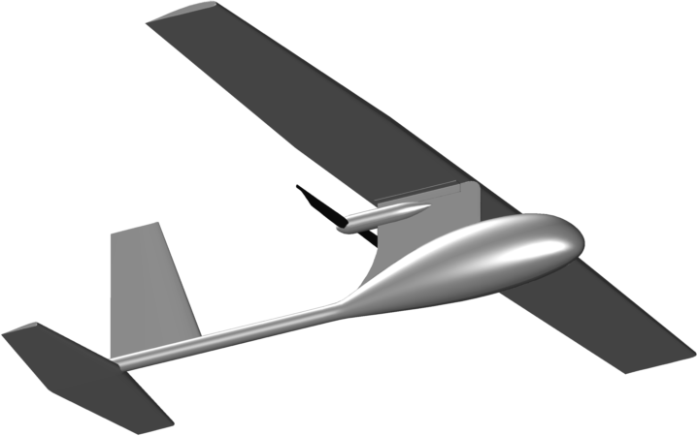
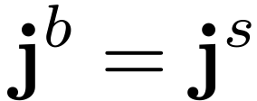



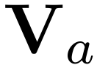
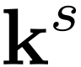
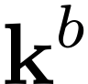
Stability Frame
Stability frame helps us rigorously
define angle of attack and is useful
for analyzing stability of aircraft
Notes:
\mathcal{R}_{b}^{s}(\alpha) =
\begin{pmatrix}
\cos\alpha & 0 & \sin\alpha \\
0 & 1 & 0 \\
-\sin\alpha & 0 & \cos\alpha
\end{pmatrix}
\mathbf{p}^{s} = \mathcal{R}_{b}^{s}(\alpha) \mathbf{p}^{b}

Slide 15
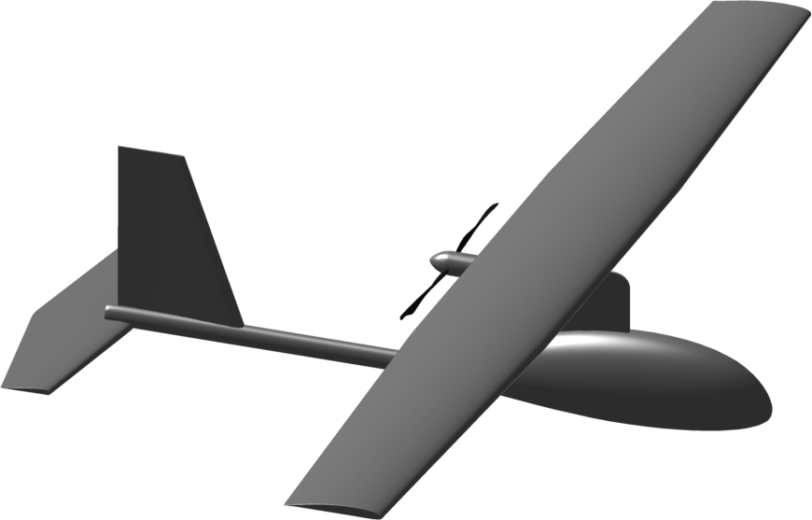
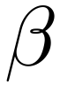



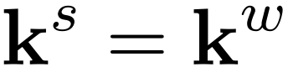
Wind Frame
Notes:
\mathcal{R}_{s}^{w}(\beta) =
\begin{pmatrix}
\cos\beta & \sin\beta & 0 \\
-\sin\beta & \cos\beta & 0 \\
0 & 0 & 1
\end{pmatrix}
\mathbf{p}^{w} = \mathcal{R}_{s}^{w}(\beta) \mathbf{p}^{s}
\mathcal{R}_{b }^{w}(\alpha,\beta) &= \mathcal{R}_{s}^{w}(\beta) \mathcal{R}_{b}^{s}(\alpha)\\
&= \begin{pmatrix}
\cos\beta & \sin\beta & 0 \\
-\sin\beta & \cos\beta & 0 \\
0 & 0 & 1
\end{pmatrix}
\begin{pmatrix}
\cos\alpha & 0 & \sin\alpha \\
0 & 1 & 0 \\
-\sin\alpha & 0 & \cos\alpha
\end{pmatrix} \\
&= \begin{pmatrix}
\cos\beta\cos\alpha & \sin\beta & \cos\beta\sin\alpha \\
-\sin\beta\cos\alpha & \cos\beta & -\sin\beta\sin\alpha \\
-\sin\alpha & 0 & \cos\alpha
\end{pmatrix}

Slide 16
Wind Frame (continued)
Wind frame helps us rigorously define side-slip angle
Side-slip angle is nominally zero for tailed aircraft
Notes:
\mathcal{R}_{w}^{b}(\alpha,\beta) = (\mathcal{R}_{b}^{w})^{\top}(\alpha,\beta) =
\begin{pmatrix}
\cos\beta\cos\alpha & -\sin\beta\cos\alpha & -\sin\alpha \\
\sin\beta & \cos\beta & 0 \\
\cos\beta\sin\alpha & -\sin\beta\sin\alpha & \cos\alpha
\end{pmatrix}

Slide 17
Airspeed, Wind Speed, Ground Speed
a/c wrt to inertial frame
expressed in body frame
wind wrt to inertial frame
expressed in body frame
ground track
a/c wrt to surrounding air
expressed in body frame
Notes:
\begin{align*}
\mathbf{V}_a &= \mathbf{V}_g - \mathbf{V}_w
\\
\mathbf{V}_g^b &= \begin{pmatrix} u \\ v \\
w\end{pmatrix}
\\
\mathbf{V}_w^b &= \begin{pmatrix} u_w \\ v_w \\ w_w\end{pmatrix} =
\mathcal{R}_{v}^{b}(\phi,\theta,\psi)
\begin{pmatrix} w_n \\ w_e \\ w_d \end{pmatrix}
\\
\mathbf{V}_a^w &= \begin{pmatrix} V_a \\ 0 \\
0\end{pmatrix}
\\
\mathbf{V}_a^b &= \begin{pmatrix} u_r \\ v_r \\ w_r \end{pmatrix} =
\begin{pmatrix} u - u_w \\ v - v_w \\ w - w_w \end{pmatrix}
\end{align*}

Slide 18
Airspeed, Angle of Attack, Sideslip Angle
Notes:
\mathbf{V}_a^b &= \begin{pmatrix} u_r \\ v_r \\ w_r \end{pmatrix} =
\mathcal{R}_{w}^{b}
\begin{pmatrix} V_a \\ 0 \\ 0 \end{pmatrix}
\\
&= \begin{pmatrix}
\cos\beta\cos\alpha & -\sin\beta\cos\alpha & -\sin\alpha \\
\sin\beta & \cos\beta & -\sin\beta\sin\alpha \\
\cos\beta\sin\alpha & 0 & \cos\alpha
\end{pmatrix} \begin{pmatrix} V_a \\ 0 \\ 0 \end{pmatrix}
\begin{pmatrix} u_r \\ v_r \\ w_r \end{pmatrix} =
V_a \begin{pmatrix} \cos\alpha \cos\beta \\ \sin\beta
\\ \sin\alpha\cos\beta \end{pmatrix}
V_a &= \sqrt{u_r^2 + v_r^2 + w_r^2} \notag \\
\alpha &= \tan^{-1}\left(\frac{w_r}{u_r}\right) \label{eq:frames-Valphabeta-to-uvw} \\
\beta &= \sin^{-1}\left( \frac{v_r}{\sqrt{u_r^2+v_r^2+w_r^2}} \right)

Slide 19
Course and Flight Path Angles
horizontal component
of groundspeed vector
Flight path projected onto ground
Notes:
$\gamma$: flight path angle
$\chi$: course angle

Slide 20
Wind Triangle
north
ground track
Notes:
$\chi$: course angle
$\psi$: heading angle
$\beta$: side slip angle
$\chi_c$: crab angle
$\chi_w$: wind direction
\chi_c \defeq \chi - \psi

Slide 21
Wind Triangle
Notes:
$\theta$: pitch angle
$\alpha$: angle of attack
$\gamma$: flight path angle
$\gamma_a$: air-mass-relative flight path angle
\gamma_a = \theta-\alpha

Slide 22
When wind speed and sideslip are zero…
Notes:
If both the windspeed and the sideslip angles are zero, i.e.,
\begin{align*}
V_w &= 0 \\
\beta &= 0
\end{align*}
then we have the following simplifications
\begin{align*}
V_a &= V_g \text{~~~Airspeed equals groundspeed} \\
u &= u_r \text{~~~Velocity equals velocity relative to the air mass}\\
v &= v_r \\
w &= w_r \\
\psi &= \chi \text{~~~Heading equals course} \\
\gamma &= \gamma_a \text{~~~Flight path angle equals air-mass-referenced flight path angle}
\end{align*}

Slide 23


Equation of Coriolis
Notes:
\mathbf{p} &= p_x \mathbf{i}^b + p_y \mathbf{j}^b + p_z \mathbf{k}^b
\\
\frac{d}{dt_i}{\mathbf{p}} &= \dot{p}_x \mathbf{i}^b + \dot{p}_y \mathbf{j}^b + \dot{p}_z \mathbf{k}^b
+ p_x \frac{d}{dt_i}\mathbf{i}^b + p_y \frac{d}{dt_i}\mathbf{j}^b + p_z \frac{d}{dt_i}\mathbf{k}^b
\\
\frac{d}{dt_b}\mathbf{p} &= \dot{p}_x \mathbf{i}^b + \dot{p}_y \mathbf{j}^b + \dot{p}_z \mathbf{k}^b
\\
\dot{\mathbf{i}}^b &= \boldsymbol{\omega}_{b/i} \times \mathbf{i}^b \\
\dot{\mathbf{j}}^b &= \boldsymbol{\omega}_{b/i} \times \mathbf{j}^b \\
\dot{\mathbf{k}}^b &= \boldsymbol{\omega}_{b/i} \times \mathbf{k}^b \\
p_x \dot{\mathbf{i}}^b &+ p_y \dot{\mathbf{j}}^b + p_z \dot{\mathbf{k}}^b
= p_x (\boldsymbol{\omega}_{b/i} \times \mathbf{i}^b)
+ p_y (\boldsymbol{\omega}_{b/i} \times \mathbf{j}^b)
+ p_z (\boldsymbol{\omega}_{b/i} \times \mathbf{k}^b) \nonumber \\
&\qquad\qquad\qquad = \boldsymbol{\omega}_{b/i} \times \mathbf{p}
\\
\frac{d}{dt_i}\mathbf{p} &= \frac{d}{dt_b}\mathbf{p} + \boldsymbol{\omega}_{b/i}
\times\mathbf{p}

Slide 24
Material Covered
Section 1 of note “Quadrotor Dynamics and Control”
Chapter 2 of book “Small Unmanned Aircraft”

